Slide 1


Sustainability Plan
2025-2026

Slide 2

Contents
Introduction
What makes us different?
Our Sustainability Commitment
Our Journey So Far
How are we offsetting?
Our Corporate Forest
Further Action to Reduce our Environmental Impact
Paving the Way to Net Zero

Slide 3

Introduction
Here at QFS, we know what it takes to keep supply chains going. Since 1995, we’ve empowered worldwide freight forwarding and management services by Air, Courier, Rail, Road and Sea. Based in the UK, with 18 regional offices, and employing 165 people, we are celebrating our 30th year of trading.
Fast Facts:
• Established in 1995
• 18 regional offices
• 165 employees
• UK based, worldwide operations

Slide 4

What Makes Us Different?
It’s our people and deep expertise across sectors as diverse as retail, pharma and construction that defines us. Born from freight heritage dating back to the 70s, strengthened by decades of industry experience and dedicated, bespoke customer service – we make it happen, every time.
Going beyond doesn’t just apply to how we do business. We are proud to have grown organically since the mid 90s, nurturing our people, encouraging individuality and personal development. Our staff wellbeing is paramount: honesty, transparency, mutual support, and high ethical standards garner an enriching working environment, where everyone feels valued. And this translates to how we treat our customers: as partners for whom we will always go the extra mile.
Our industry leadership is underpinned by the highest quality standards, including ISO45001:2018, ISO9001:2015, Cyber Essentials and IATA accreditations, to name but a few. You can be assured that, with QFS, peace of mind is a given.
As a logistics business, we are serious about our responsibility to contributing to the Net Zero revolution and are ensuring we are doing our part to protect people and planet.

Slide 5

Our Sustainability Commitment
“As we believe in solid actions, not just promises, we have set clear goals for both short and long term to reduce our impact on the planet.”
Duncan Winn – Chief Executive Officer

Slide 6

The Journey So Far
Benchmarking
Having undergone a carbon baseline assessment, we now understand the volume of our carbon emissions. The process involved gathering data from all company sites, along with surveys to understand commuting and homeworking data. This data was focused on business operations – once we understood the volume of emissions, we could start work to offset and reduce these.
Goal Setting
In the next year:
5% reduction in carbon emissions in financial year 2025-26, as compared to 2024-25
In the next 5 years:
Becoming paperless by moving to a digital/cloud based operation
Choosing suppliers who have their own carbon reduction schemes
Offering flexible working to reduce commuting emissions
Being travel conscious and using the train or public transport options where possible
Ongoing Measurement
Undergo emissions reports quarterly plus an annual report. This is to ensure that we are measuring our footprint and understanding where we can make reductions in our emissions and how much we should offset
To understand our freight emissions (not just core business operations) by 2035 in order to take action
Our carbon emissions measured in the financial year of 2023-24 have now been successfully offset. During 2023-24, we have reduced our overall emissions from 245 tonnes of CO2e to 197 (nearly 20%), which is a fantastic achievement.

Slide 7
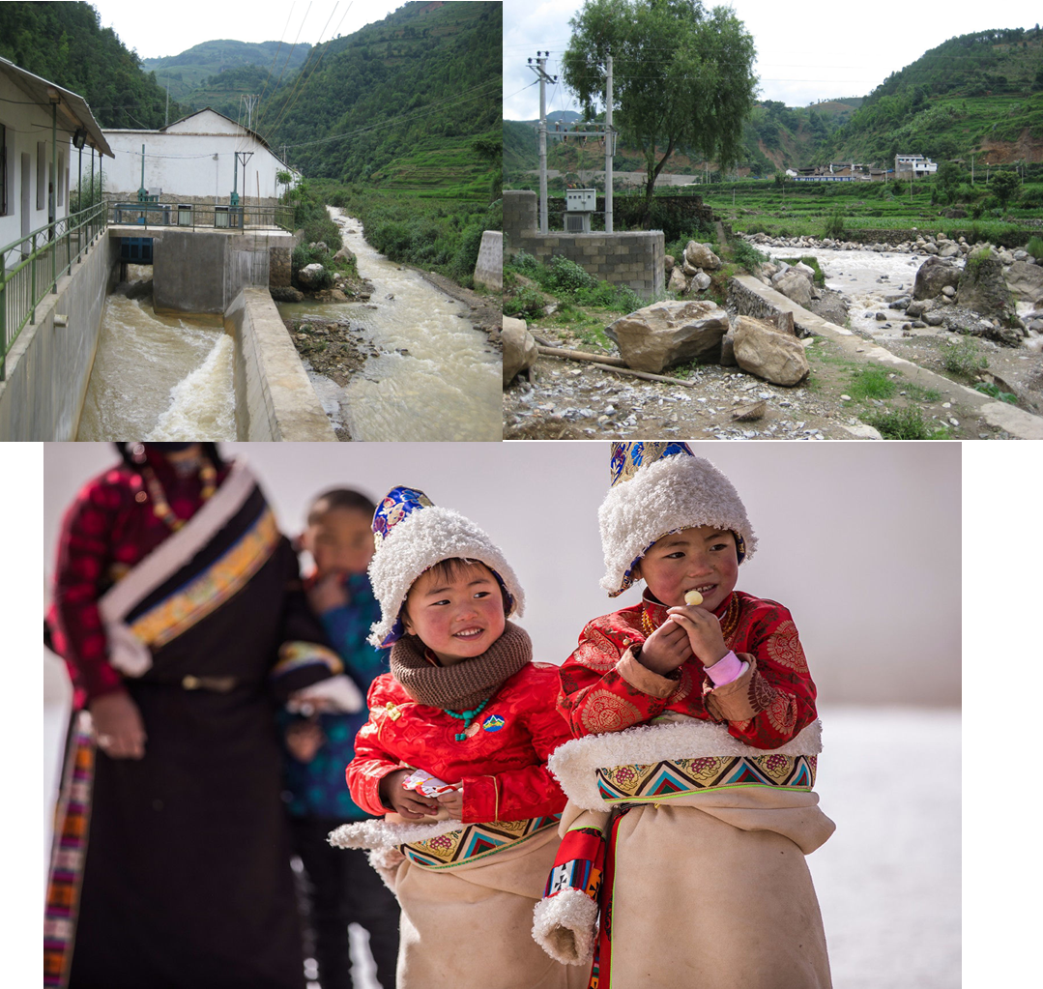


How are we Offsetting?
We have carefully chosen projects to invest in that not only contribute to our Net Zero ambitions, but support developing countries’ economic and social evolution.
The chosen project was the Sichuan Miyaluo Hydroelectric Station – (Accredited by the United Nations)
This project is strategically located in the economically disadvantaged Tibetan region of Sichuan Province, China, contributing to regional development and sustainability. Two percent of the power station's annual income is allocated to environmental protection, demonstrating a strong commitment to sustainable practices.
Placing a high priority on ecological conservation by safeguarding fish migration pathways and ensuring minimal harm to the local ecosystem, this commitment reflects a balance between harnessing energy and preserving nature, whilst actively supporting local schools by donating funds, fostering educational development within the community. This project establishes scholarships to support underprivileged students, with a specific focus on Tibetan students, breaking down barriers to education and contributing to a brighter future.
The initiative has created 14 job positions for residents, contributing to local employment opportunities and local infrastructure development, particularly in the improvement of transportation, enhancing overall community well-being.
By investing in the project, we have offset our carbon emissions for 2023-24
(197 tonnes of CO2e), which is the equivalent of 100 return flights from
Manchester, UK to JFK, New York, USA.
United Nations Certified Project

Slide 8










Our Corporate Forest, Uganda - 50p a Tree
To further our green commitment, we are creating our own corporate forest in Uganda, to absorb carbon and enrich local communities . This has converted previously barren ground into rich farming land, home to various crops and fruit trees.
The programme meets 9 of the 17 sustainability goals , helping the local community in multiple ways:
• Improving wellbeing by reducing poverty, achieving food security, and improving nutrition
• Teaching locals to farm, providing employment, leading to wider economic growth
• Protecting and restoring ecosystems, with sustainable farming methods
Quality Freight Services Limited are investing in the growth of our forest on a quarterly basis – which will continue to absorb carbon from the atmosphere, create jobs and restore land.
Learn more about the Project and Sustainability Goals here <https://www.carbonneutralgroup.co.uk/50p-a-tree.html>
Goal 1:
End poverty in all its forms everywhere
Goal 3:
Ensure healthy lives and promote well-being for all at all ages
Goal 10:
Reduce inequality within and among countries
Goal 13:
Take Urgent Action to Combat Climate Change and Its Impacts
Goal 17:
Strengthen the means of implementation and revitalize the global partnership for sustainable development
Goal 2:
End hunger, achieve food security and improved nutrition and promote sustainable agriculture
Goal 8:
Promote sustained, inclusive and sustainable economic growth, full and productive employment and decent work for all
Goal 12:
Ensure Sustainable Consumption and Productive Patterns
Goal 15:
Protect, restore and promote sustainable use of terrestrial ecosystems, sustainably manage forests, combat desertification, and halt and reverse land degradation and halt biodiversity loss.

Slide 9

Further Action to Reduce our Environmental Impact
Renewable Energy
81 solar panels were installed into our Shipley Head Office in January 2024. Since the installation, we have saved 5,140kg of CO2e due to the creation of renewable energy, which is the equivalent 75,294km driven ‘on sunshine’.
Digitisation
We are improving our digital infrastructure and moving it from on-premises to a cloud-based solution, which will reduce our carbon footprint and energy consumption.
Championing Local
Local suppliers are always our first choice. In Yorkshire, our solar panels are from Harrogate, our training provider is in Otley, and our digital agency hails from Halifax. We also support fledgling businesses such as our website designers, to encourage enterprise and further contribute to the local economy.
Travel & Commuting
Transport contributes to around one-fifth of global CO2 emissions . Being in the logistics business, we are doing our utmost to mitigate its effect. We encourage our partners to work towards high sustainability standards and work hard to reduce our internal travel emissions. Our 80-strong fleet is comprised of hybrid or fully electric vehicles and staff are encouraged to use public transport. In addition, we fully support flexible working and working from home.
Recycling
We are proud to be recognised members of the UK Vehicle Recyclers’ Association, the trade body of vehicle recycling professionals since 1943, along with the British Metals Recycling Association.
Since 2021, we also support Breast Cancer Awareness via their printer cartridge recycling initiative.

